Slide 1
AnalyticaLab
Call Center Performance Analysis

Slide 2



AnalyticaLab
Overview
Introduction Data Description
Problem Statement Data Cleaning and Preparation Dashboard Overview Dashboard
Key Insights Recommendations and Actionable Insights
03
04
05
06
07
08
09
11

Slide 3




Introduction
This project was initiated at the request of Claire, the Call Centre Manager at PhoneNow, with the aim of providing transparency and actionable insights into the performance of the call center. The objective was to create a dashboard that visualizes critical metrics related to call center operations, allowing management to easily interpret long-term trends in both customer and agent behavior. By utilizing Power BI, this dashboard enables a clear overview of the data, facilitating informed decision-making and operational improvements.
AnalyticaLab

Slide 4


AnalyticaLab
Data Description
Call Id
A unique identifier for each call in the dataset
Topic
The subject or category of the call (e.g., technical support, payment, streaming).
Agent
The name or identifier of the agent handling the call.
Answered (Y/N)
Indicates whether the call was answered (Yes) or missed (No)
AvgTalkDuration
The average duration of the call conversation.
Time
The time when the call took place
Resolved
Shows whether the issue discussed on the call was resolved (Yes/No)
Satisfaction Rating
The customer’s feedback on the call, representing overall satisfaction on a scale.
Date
The date the call occurred.
Speed of Answer in seconds
The time taken to answer the call, measured in seconds

Slide 5



AnalyticaLab
Problem Statement:
PhoneNow's call center management is facing challenges in monitoring and analyzing key performance indicators (KPIs) such as total calls, call resolution rates, agent performance, and customer satisfaction.
Without a clear and comprehensive view of these metrics, it is difficult to identify trends, optimize resource allocation, and enhance overall service quality.
A solution is needed to provide transparency, enable data-driven decision-making, and ensure continuous improvement in call center operations.

Slide 6



Data Cleaning and Preparation
AnalyticaLab
Data Source : PwC Switzerland
During the initial data exploration, null values and inconsistent entries were identified in the columns.
Blank/null values in relevant columns were addressed using Power BI’s Power Query editor.
After cleaning, data was prepared using DAX functions for advanced calculations
The cleaned and prepared data was then modeled to provide accurate insights, ensuring that all null values were handled appropriately, and calculations were error-free.

Slide 7


Dashboard Overview
AnalyticaLab
This dashboard provides a comprehensive visualization of key call center metrics, enabling clear insights into overall performance and operational trends
04
Total Call Summary
Breakdown by Agent
Speed of Answer
Issue Resolution by Topic
Call Trends by Month
Call Breakdown by Topic

Slide 8

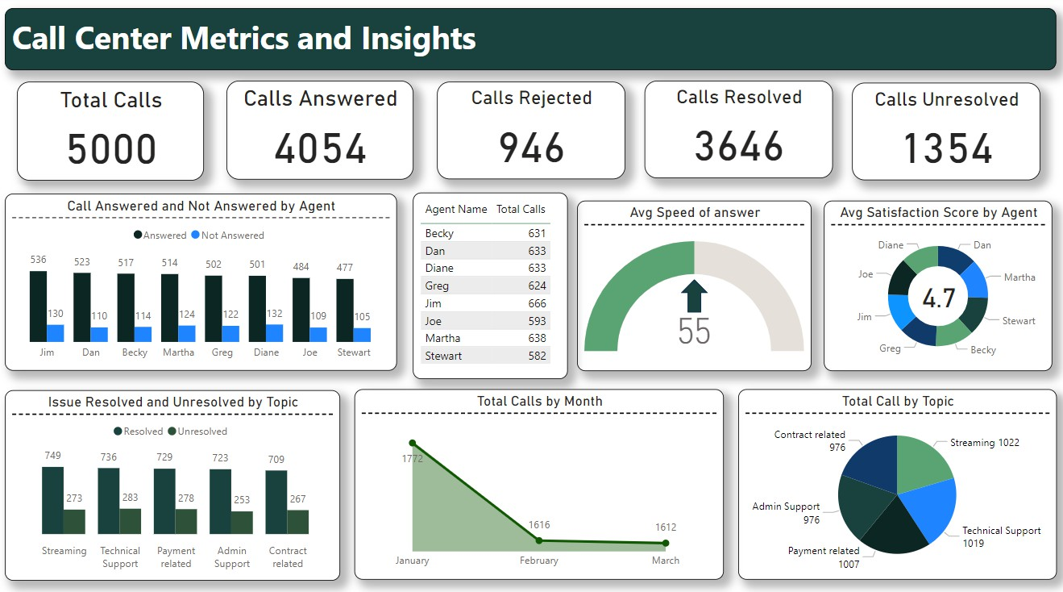

Slide 9


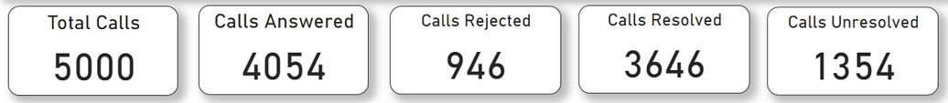
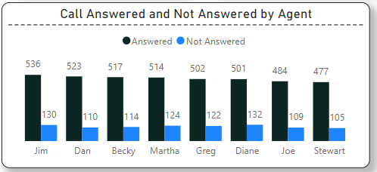
Key Insights
AnalyticaLab
High Call Volume
A total of 5,000 calls were handled, with 4,054 calls successfully answered and 946 calls rejected.
Agent Performance
Jim handled the most calls (536 answered), while Stewart had the fewest answered calls (477).
Satisfaction scores across agents are fairly consistent, with an average rating of 4.7.
Call Trends
Calls decreased steadily from January (1,772) to March (1,612), indicating a downward trend in call volume over the months.

Slide 10

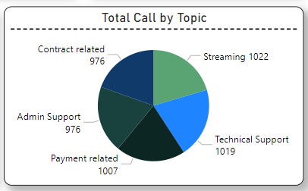
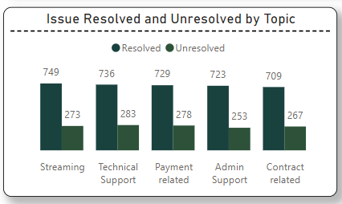
AnalyticaLab
Average Speed of Answer
The average speed of answer is 55 seconds, reflecting a reasonable response time.
Topic Distribution
Streaming and technical support generated the most calls, highlighting areas that require ongoing attention.
Resolution Efficiency
Out of 5 key issue categories, streaming-related issues had the highest resolution rate (749 resolved), while contract-related issues had the lowest (709 resolved).

Slide 11


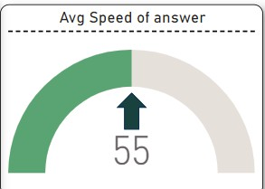
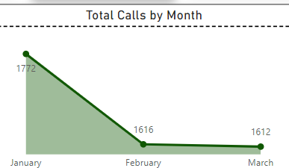
Recommendations and Actionable Insights
AnalyticaLab
Improve Call Answer Rates
Stewart and Joe have lower call answer rates, and improving their performance could be achieved through training or better workload distribution to enhance overall efficiency.
Focus on Speed of Answer
Despite a 55-second average speed of answer, improvements can be made by optimizing call routing or increasing staff during peak times to reduce response time further.
Monitor Declining Call Volume
The drop in call volume from January to March may indicate a seasonal trend or declining customer engagement, requiring further analysis to identify the cause and develop appropriate strategies.

Slide 12



THANK YOU
AnalyticaLab
For watching this presentation
Dipanshu Gupta
8427706063
dipanshugupta780@gmail.com

